Slide 1

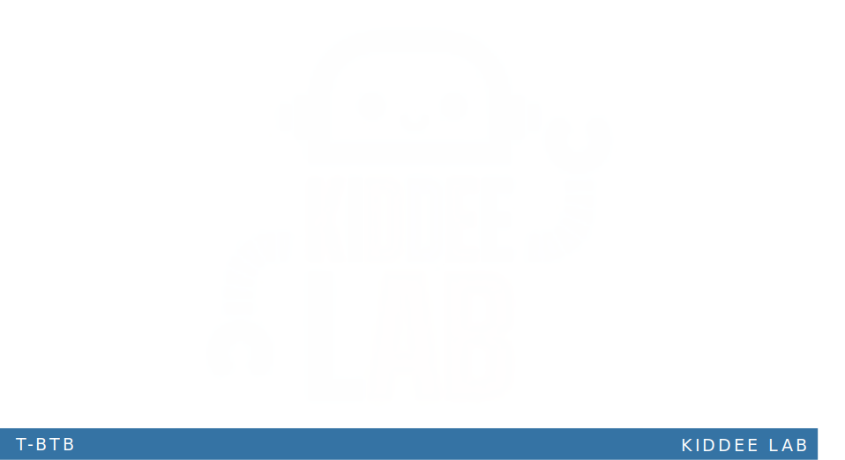
Cross Validation

Slide 2
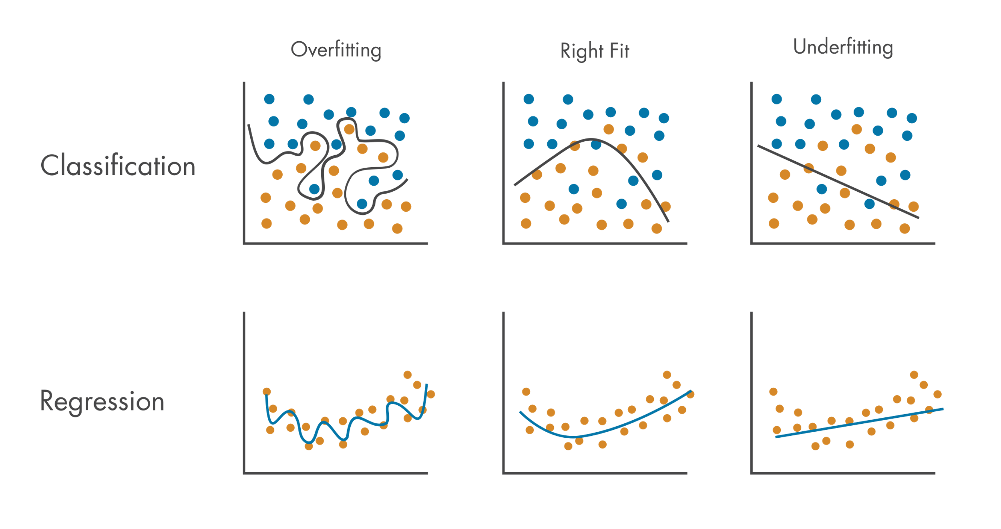
What is the problem?
Learning the parameters of a prediction function & testing it on the same data is wrong!!!
A model perform a perfect score by repeating the labels of the seen samples, but might fail to predict on unseen data. (Over-fitting)

Slide 3
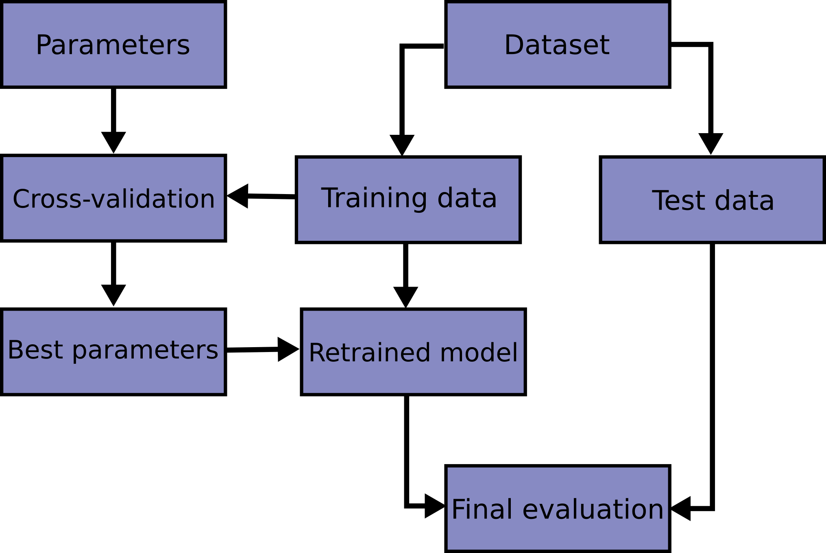
What is cross validation (CV)?
There is no validation set anymore.
k-fold CV, the training set is split into k smaller sets
The following procedure is followed for each of the k “folds”:
A model is trained using k−1 of the folds as training data;
the resulting model is validated on the remaining part of the data (i.e., it is used as a test set to compute a performance measure such as accuracy).

Slide 4


